Slide 1
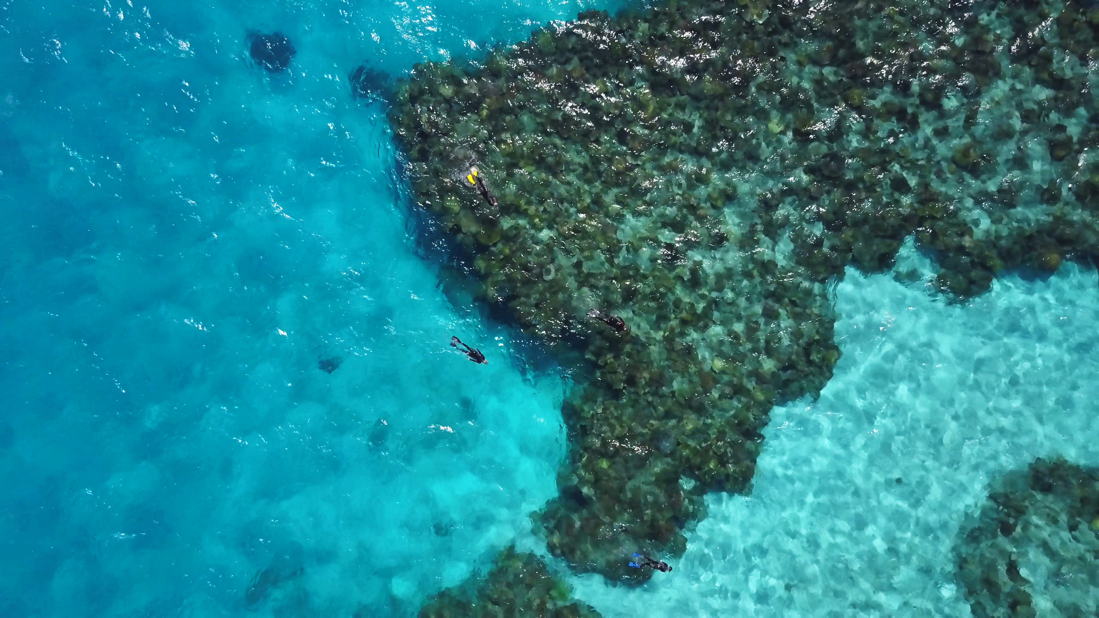
Local Indigenous Business Expenditure
2021 Financial Year

Slide 2
Our Journey
August
2019
Council adopted recommendations to support local First Nation People by committing to increase spend with Indigenous Suppliers.
The target established was Townsville City Council spending 3% of its addressable expenditure with Indigenous businesses by 2025.
Council approved the establishment of Townsville City Council’s first Indigenous Supply Panel.
58 Indigenous Business were added at the commencement of the panel.
$726,000 actual expenditure with Indigenous Businesses in the 6 months to 30 June 2020. This expenditure exceeds Council’s Indigenous Business expenditure target of $703,000 for June 2020.
First Indigenous Supply Panel refresh completed – 8 additional suppliers added to Panel.
2020
Financial
Year
2021
Financial
Year
$2.447M actual expenditure with Local Indigenous Businesses for the 2021 Financial Year. This expenditure exceeds Council’s Local Indigenous Business expenditure target of $1.617M for the financial year.
For Council projects, suppliers achieved secondary expenditure of $260k with local Indigenous Businesses.
The Indigenous Supply Panel refresh delivered four additional suppliers added to Panel.
Indigenous Business Expenditure – 2021 Financial Year

Slide 3
Performance Summary
Procurement Targets
0.6% - Jan-Dec 2020
1.2% - Jan-Dec 2021
1.8% - Jan-Dec 2022
2.4% - Jan-Dec 2023
3.0% - Jan-Dec 2024
4.0% - Jan-Dec 2025
5.0% - Jan-Dec 2026
Council has an annual expenditure target for Procurement Expenditure with Local Indigenous Businesses.
This target increases each calendar year to support local Indigenous businesses to build operation capacity.
The expenditure targets commenced January 2020.
Period | Target | Target |  | Actual
 | % | $ |  | % | $
Jan-Dec 2020 | 0.6% | 1.284M |  | 0.75% | 1.603M | Target Achieved | Expenditure target exceeded by $319k
Jan-Dec 2021 (June YTD) | 1.2% | 1.036M |  | 1.82% | 1.569M | Exceeding YTD Target | Annual target on track to be achieved Target expected to be achieved in Oct’21
Indigenous Business Expenditure – 2021 Financial Year

Slide 4
Local Indigenous Business Expenditure – FY21
Whole of Council - Monthly
Whole of Council - Accumulative
TCC exceeded its Indigenous procurement targets in 8 of the 12 months in FY21.
June 2021 was the highest expenditure month of year with several Indigenous businesses delivering capital projects for Council.
At 30 June 2021, Actual Expenditure with Indigenous Businesses is $2.447M, this is $839k above the target of $1.617M
Indigenous Business Expenditure – 2021 Financial Year

Slide 5
Local Indigenous Business Expenditure – FY21
Expenditure by Section
Infrastructure
& Operations
Infrastructure
& Operations
Infrastructure &
Operations
Infrastructure &
Operations
Business
Services
Business
Services
Office of the CEO
Indigenous Business Expenditure – 2021 Financial Year

Slide 6
Local Indigenous Business Expenditure – FY21
Secondary Local Indigenous Supplier Expenditure
In addition to Council’s direct expenditure with Indigenous Businesses for the 2021 financial year of $2.447M, Council has achieved additional ‘secondary’ expenditure with Local Indigenous Suppliers for the same period of $260k.
Secondary Expenditure is expenditure Council’s suppliers have had with Local Indigenous Suppliers on Council projects. This secondary expenditure is self reported by Council’s suppliers.
Civil Plus engaged Mundey’s Contractors to deliver Kerb and Channel works at several of their construction sites in the 2021 Financial Year.
In addition, Revegetation Contractors engaged Woongal Environment Services to provide vegetation rehabilitation at the site of Stage One of the Haughton Pipeline Duplication project.
Indigenous Business Expenditure – 2021 Financial Year

Slide 7
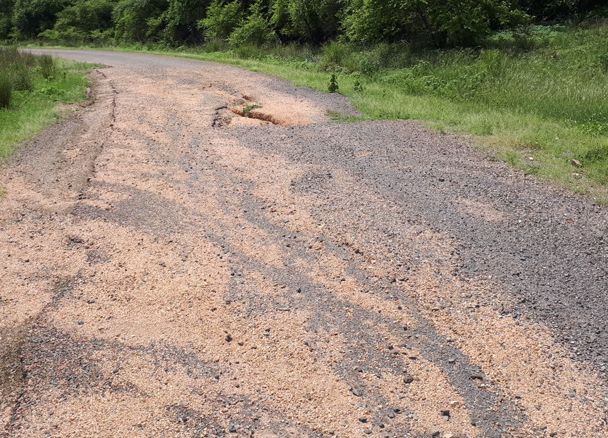
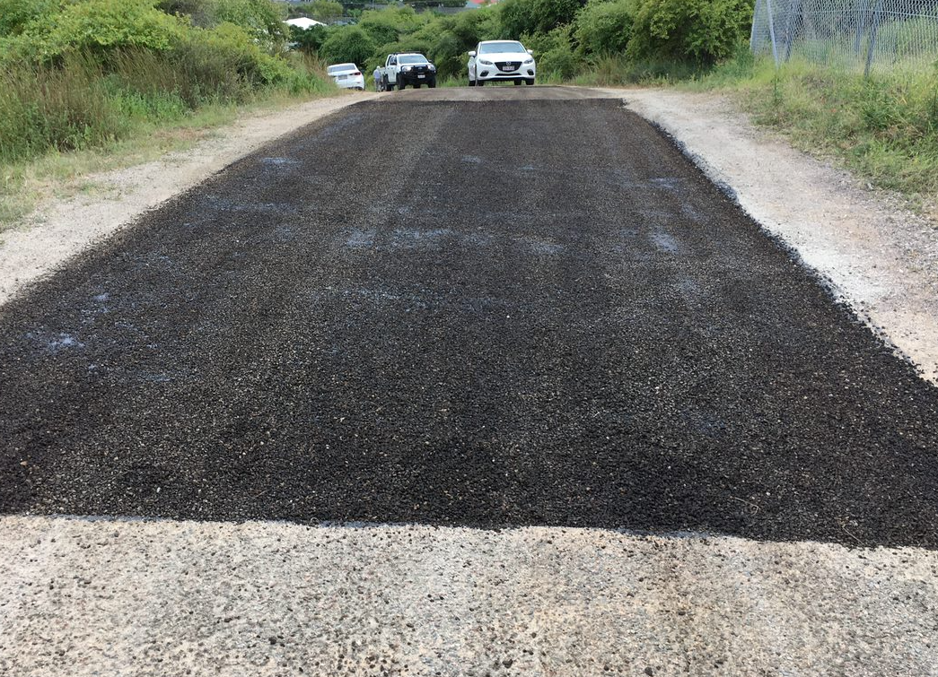
Our Highlights
Supplier Highlights
Before
Local Indigenous Supplier Absolute Building Supplies were the first business to assist council at the height of the COVID-19 pandemic by supplying council with 3,000 litres of hand sanitizer. The business continued to support Council’s pandemic requirements in the 2021 financial year by providing further sanitiser products and face masks. Absolute Building Supplies leveraged its position on the Townsville City Council Indigenous Supply Panel (having an established Government Arrangement) to provide sanitiser and other hygiene goods to other government entities.
Waanyi Shamrock United are a local Indigenous Joint Venture business that civil construction services. solutions. Waayni were engaged by Council’s PMO team to renew access roads for bulk water assets.
Three Big Rivers, Biodiversity Australia and The Vegetation Guys were engaged by Council’s Environmental Services team in March 2021 to deliver Council’s requirements under the Reef Assist Grant. The funding has enabled each organisation to employ five trainees to deliver vegetation and landscape management service to support the health of the Great Barrier Reef. The majority of trainees hired by these organisations are Indigenous.
Before
After
After
Douglas Access Road – Before and After
Indigenous Business Expenditure – 2021 Financial Year

Slide 8
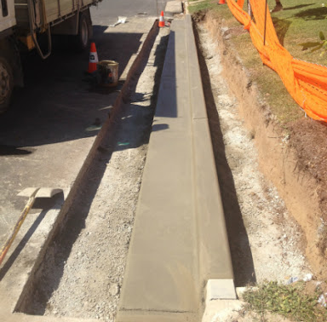
Our Highlights
Supplier Highlights
The Vegetation Guys are not just a local Indigenous business but they are also a not for profit organisation that provides valuable transition employment for veterans in all conditions as they leave Defence, in particular sufferers of PTSD. The business provided Council with a significant level of support with emergent vegetation management works. By supporting this local organisation, Council are not only supporting an Indigenous Business and local employment but also contributing to the wellbeing of our veterans recovering from both physical and mental illnesses.
Mundey’s Contractors is Council’s highest spend Indigenous supplier. The supplier provides Council’s kurb and channel capital and renewal works across the Townsville LGA. The supplier was engaged by the CMO Civil team and is now a preferred supplier for Council.
What-Tree Stumping were initially engaged by the Parks and Opens Space team (POSE) in the 2020 Financial Year to complete tree removals, dead wooding and clearance pruning of all trees within Scarisbrick Park located in Kirwan. The feedback from the POSE team was the crew from What-Tree Stumping did an amazing job to bring the park back to a state that is now considered visually appealing to all residents. The supplier has continued to be engaged in the 2021 Financial Year delivering an exceptional service. The supplier is now a preferred supplier and is regularly engaged by Council.
Indigenous Business Expenditure – 2021 Financial Year

